Slide 1
BUDGET CONSTRAINT

Slide 2
Introduction
Economists assume that consumers choose the best bundle of goods they can afford. Now, we have to describe more precisely what we mean by “best” and what we mean by “can afford.
In real life there are many goods to consume, but for our purposes it is convenient to consider only the case of two goods, since we can then depict the consumer’s choice behaviour graphically.
We will indicate the consumer’s consumption bundle by (x, y). This is simply a list of two numbers that tells us how much the consumer is choosing to consume of good 1, x, and how much the consumer is choosing to consume of good 2, y.

Slide 3
We suppose that we can observe the prices of the two goods, (p1, p2) and the amount of money the consumer has to spend, m. Then the budget constraint of the consumer can be written as
p1x + p2y ≤ m.
The consumer’s affordable consumption bundles are those that don’t cost any more than m. We call this set of affordable consumption bundles at prices (p1, p2) and income m the budget set of the consumer.
Two goods are often enough

Slide 4
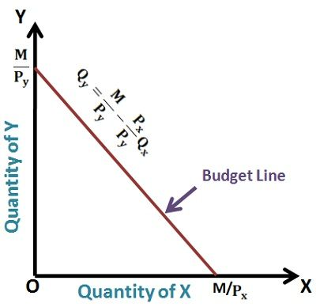
Budget line
The budget line is the set of bundles that cost exactly m

Slide 5
Slope of the budget line
The slope of the budget line has a nice economic interpretation. It measures the rate at which the market is willing to “substitute” good x for good y.
The slope of the budget line measures the opportunity cost of consuming good 1. In order to consume more of good x you have to give up some consumption of good y. Giving up the opportunity to consume good y is the true economic cost of more good x consumption; and that cost is measured by the slope of the budget line.

Slide 6
How the budget line changes?
First consider changes in income. An increase in income will increase the vertical intercept and not affect the slope of the line. Thus an increase in income will result in a parallel shift outward of the budget line.
Now consider changes in prices. Increasing p1 will not change the vertical intercept, but it will make the budget line steeper since p1/p2 will become larger.

Slide 7
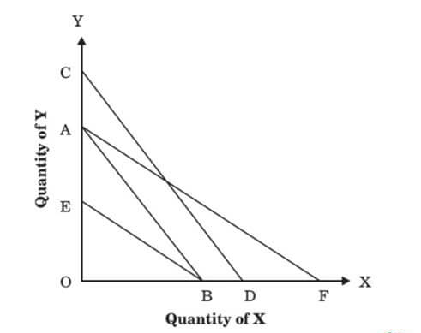
Shifts due to income and price changes

Slide 8
What happens to the budget line when we change the prices of good 1 and good 2 at the same time? Suppose for example that we double the prices of both goods 1 and 2. In this case both the horizontal and vertical intercepts shift inward by a factor of one-half, and therefore the budget line shifts inward by one-half as well. Multiplying both prices by two is just like dividing income by 2.

Slide 9
What if income decreases and prices increase?
If m decreases and p1 and p2 both increase, then the intercepts m/p1 and m/p2 must both decrease. This means that the budget line will shift inward.
What about the slope? If price 2 increases more than price 1, so that −p1/p2 decreases (in absolute value), then the budget line will be flatter; if price 2 increases less than price 1, the budget line will be steeper.

